Slide 1
Measuring Inequality of Public Services Distribution with Spatial Data: Case of Egypt

Slide 2
Can spatial, data-driven mapping of public services inequality improve redistribution preferences among policy-makers?

Slide 3
Motivation
Legislators are incentivised to prioritize the interests of their constituencies, even at the expense of balanced distribution of public services.
In the absence of national, non-politicized data on distribution of public services, public spending is likely to favour more resourceful legislators.
One way to break this vicious cycle is to present different information (on unequal distribution of public services), in a different way.

Slide 5
Design
Develop a ‘map of public services’ based on spatial data that overcomes the unreliability of government data and surveys.
Providing a sample of legislators (just a few weeks before the budget parliamentary debates start), with an option to access that map.
Dependent variables:
1. how far would legislators access the data, measured by the number of accesses to a portal specifically designed for that purpose.
2. whether they would make use of such data in their interventions in parliament, in comparison to previous year’s transcripts (when the portal did not exist) - measured via text analysis of parliamentary transcripts.

Slide 6
Design
Develop a ‘map of public services’ based on spatial data that overcomes the unreliability of government data and surveys.
Providing a sample of legislators (just a few weeks before the budget parliamentary debates start), with an option to access that map.
Dependent variables:
1. how far would legislators access the data, measured by the number of accesses to a portal specifically designed for that purpose.
2. whether they would make use of such data in their interventions in parliament, in comparison to previous year’s transcripts (when the portal did not exist) - measured via text analysis of parliamentary transcripts.
Preliminary Findings
Can only happen in Feb and March
Can only happen April to June

Slide 7
Developing Spatial Map
Low and low-middle income countries have structural problems in generating official developmental data, especially if such data are likely to expose significant inequalities or ill-targeted public spending.
Data collection in such settings is usually marred with many challenges:
1. survey data never go down to low administrative levels, are done over long cycles and suffer from reliability concerns (ADB 2022)
2. official data usually suffer from significant lags, not disaggregated enough and sometimes incomplete (Hassan and Amin 2022 ).
Result is a situation where unequal distribution of services is visible to everyone, yet hardly captured by reliable datasets when the decisions to re-allocate resources are being made.

Slide 8
Methodology
Geospatial data has been used extensively for development studies, tracing:
- nighttime light (Yanhua, X.; Qihao, W.; Anthea, W, 2014; Liu, Q, 2017).
- vegetation differences (Gessesse and Melesse 2019).
- rainfall statistics(Simpson, M, 2018).
We aim for data that would be less contested and usable by MPs in budgeting debates.
We geotag ‘points of interest’ (POIs) distribution of to 4 ‘inequality reducing/poverty alleviating’ services across constituencies.
- schools.
- health care clinics/hospitals.
- subsidized food outlets/distribution points.
- youth centers/clubs.

Slide 9
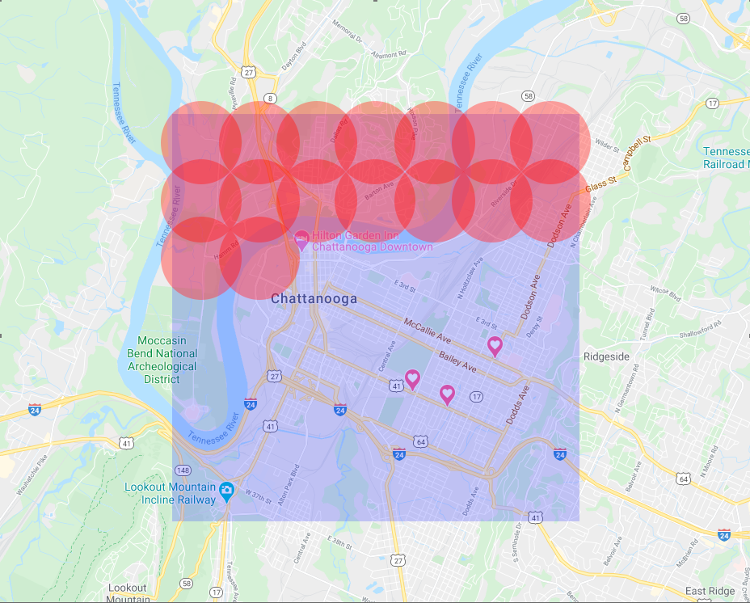
Geotagging
Compiled a list of potential keywords that represent our four targeted POIs.
Identified constituency boundaries (latitude and Longitude) from UN Humanitarian Data Exchange platform (OCHA, 2017).
Number POIs in each constituency was scraped from Google Maps API (argo code script).
As Google Maps API limits the number
of places returned per query to 60, we
divided constituencies into circles,
enabling us to recursively call the API in
this boundary to scrape everything
without the 60 responses limit.

Slide 10
Geotagging
In phase 1, we limited our search to constituencies where we can validate our data, against existing (relatively reliable) data on poverty.
One-off survey on the poorest 1,000 villages in Egypt (out of 5,000) which produced data on no. of poor people and poverty rate in these villages.
Applied such villages as our measure of poor constituencies and compared them against the capital of each governorate.
A total of 24,165 POIs were retrieved.
Schools | 16,980
Health care clinics/hospitals | 4,459
Youth Centres | 1,615
Subsidized food outlets | 1,111

Slide 11
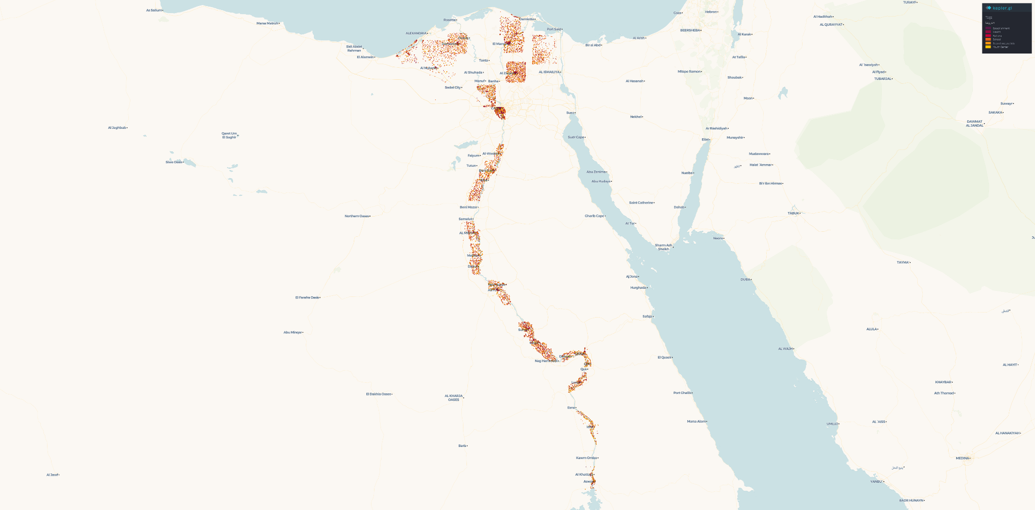
POIs distribution

Slide 12
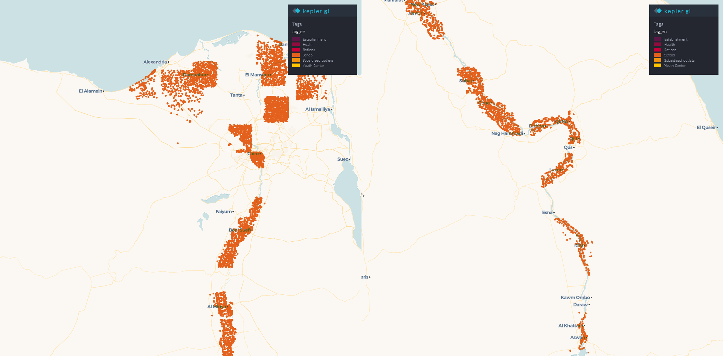
Schools’ POI distribution across the regions

Slide 13
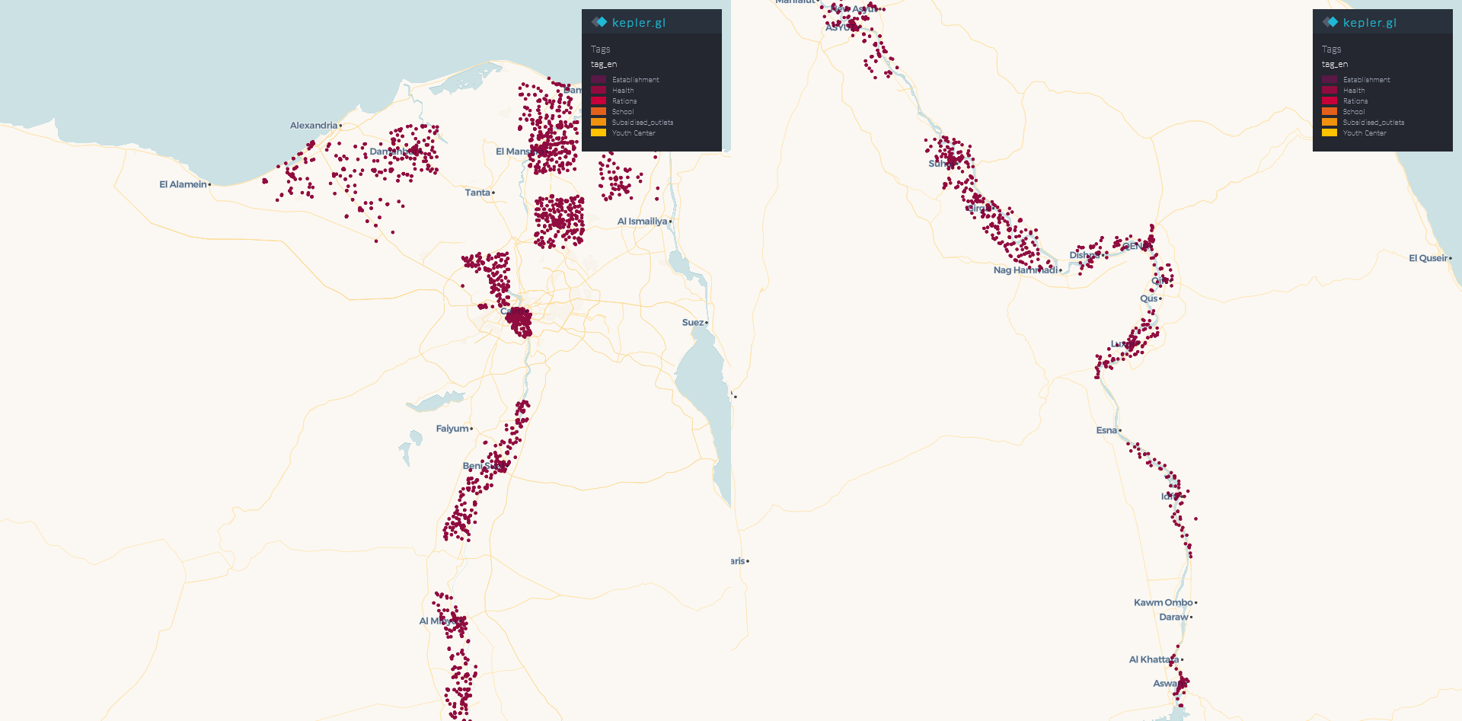
Clinics’/hospitals’ POI distribution across the regions

Slide 14
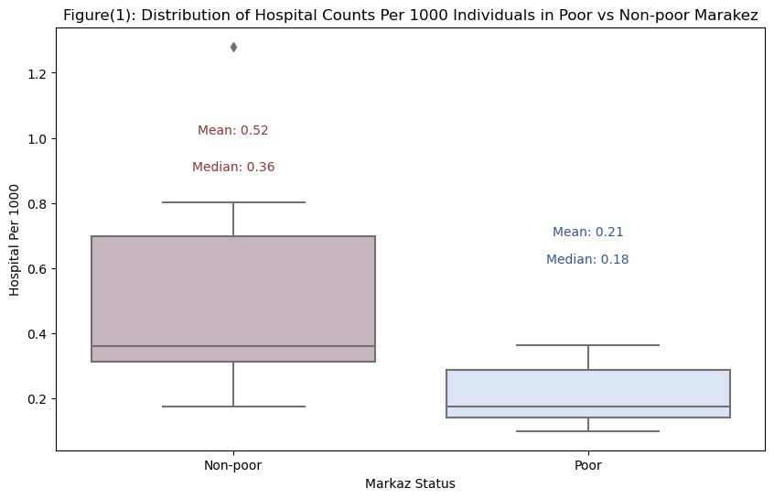
Validation: hospitals (weighted by population)
1% significance level, T-test (pvalue = 0.0011889), MannWhitney (pvalue = 0.0018596)

Slide 15
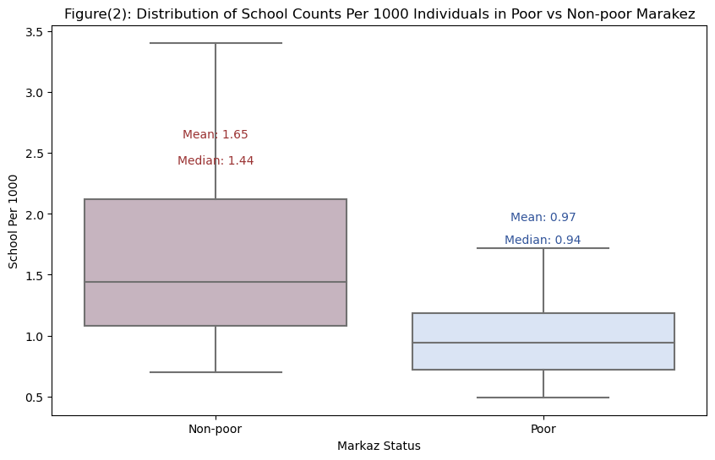
Validation: schools (weighted by population)
5% significance level, T-test (pvalue = 0.0060690), MannWhitney (pvalue = 0.025260)

Slide 16
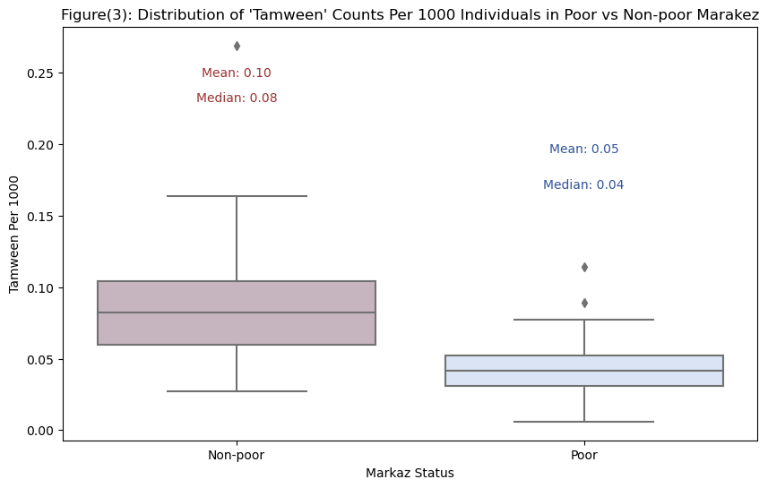
Validation: subsidized food outlets (weighted by population)
5% significance level, T-test (pvalue = 0.0109457), MannWhitney (pvalue = 0.022089)

Slide 17
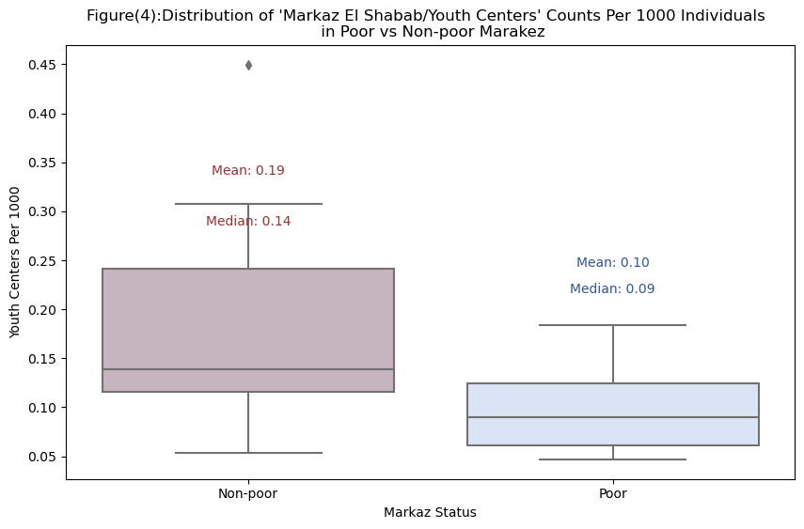
Validation: youth centres/clubs (weighted by population)
5% significance level, T-test (pvalue = 0.00674526), MannWhitney (pvalue = 0.0192699)

Slide 18
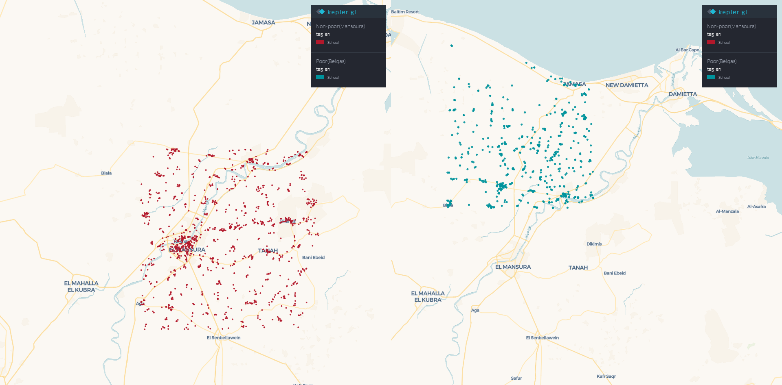
Validation: comparing POIs in the same governorate
Mansoura (non-poor) has twice as many schools as Belqas (poorest), 1378 compared to 620.

Slide 19
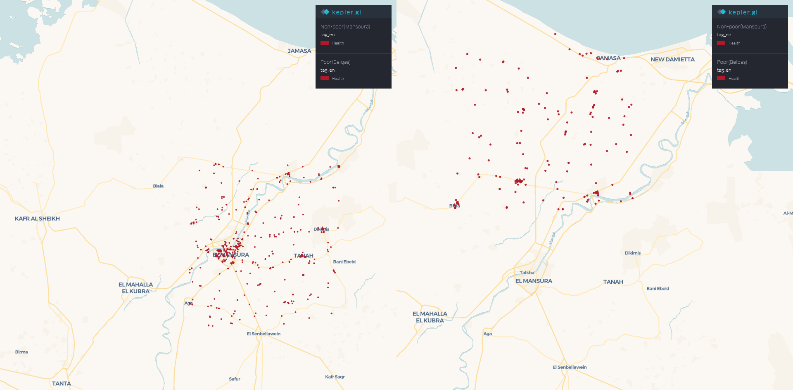
Validation: comparing POIs in the same governorate
Mansoura (non-poor) has almost three times the number than those of Belqas (poor), at 454 and 185.

Slide 20
Experiment
Option 1: Field Experiment.
Inviting legislators to a seminar where we show them data and give them access.
Trace how far they use data in budgeting debates compared to last year.

Slide 21
Option 2: Lab Experiment
Subjects divided into groups of 3: legislators representing constituencies of three different SES (poor, average, better-off).
Task is to reach agreement on funding of a specific number of schools/hospitals/food outlets/youth centres in a certain time period.
Subjects incentivised via payoffs to get higher share for their constituencies.
Subjects need to chat to decide. If no decision is reached, no one gets paid.
To reflect different resources of legislators, higher SES legislators would have double chatting time.
Two treatments:
DV: how far legislator representing higher SES constituency would accept redistribution, at the expense of payoffs.
Control | No mapping
T1 | Mapping available

Slide 22
Thanks

